Slide 1
Introduction to Machine Learning
Data Max

Slide 2
What is Machine Learning (ML)?
Goal
Machines that learn to perform a task from experience
Why?
Task cannot be well defined
Volume is too big to analyze
Environment changes
New knowledge becomes available

Slide 3
ML: Learning
Learning to perform a task from experience
Learning
Most important!
We don’t want to encode knowledge
Machine should discover and learn relevant criteria automatically from past observations
Tools
Statistics
Probability Theory
Decision Theory
Information Theory
Optimization Theory

Slide 4
ML: Task
Learning to perform a task from experience
Task
Usually a function
y = f(x,w)
x: input aka. features
y: output aka. target
w: parameters
Classification vs. Regression
Classification: discrete y
Regression: continuous y

Slide 5
Regression
Examples:
Forecasting of the price
Evaluation of an asset (house, car, plot of land)
Prediction of sales for a product

Slide 6
Classification
Examples:
Character recognition (OCR)
Email filtering
Image classification

Slide 7
ML: Perform
Performance
“99% correct classification”
Of what??
What training/testing data set?
Is it matching reality?
Performance Measure:
Typically a number
Different for classification vs. regression

Slide 8
ML: Experience
Experience
When labeled data available:
Supervised learning
No labeled data available
Unsupervised learning
Some labeled data available
Semi-supervised learning
Feedback/rewards
Reinforcement learning

Slide 9
Basic Algorithms
Linear Regression
Logistic Regression
SVM
Decision Tree (Forest)
Naïve Bayes
K-Means Clustering
DBSCAN Clustering

Slide 10
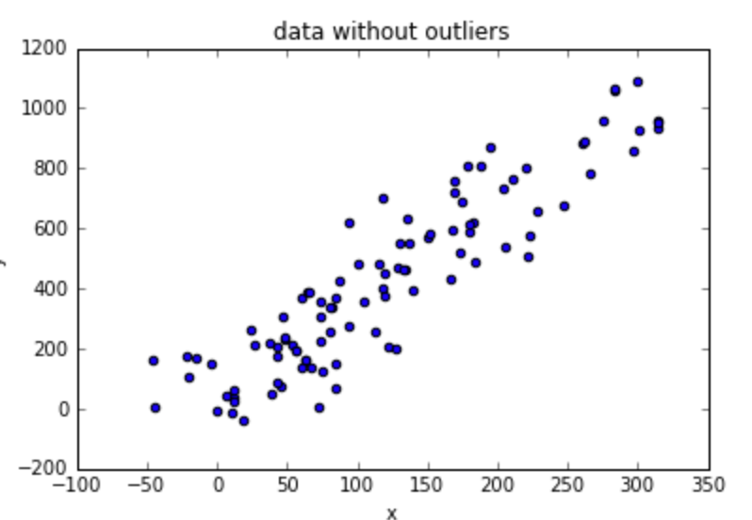
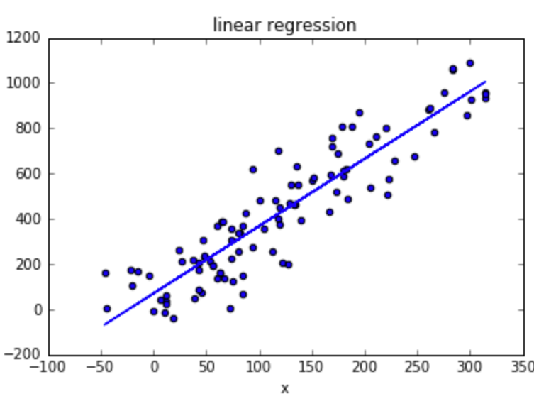
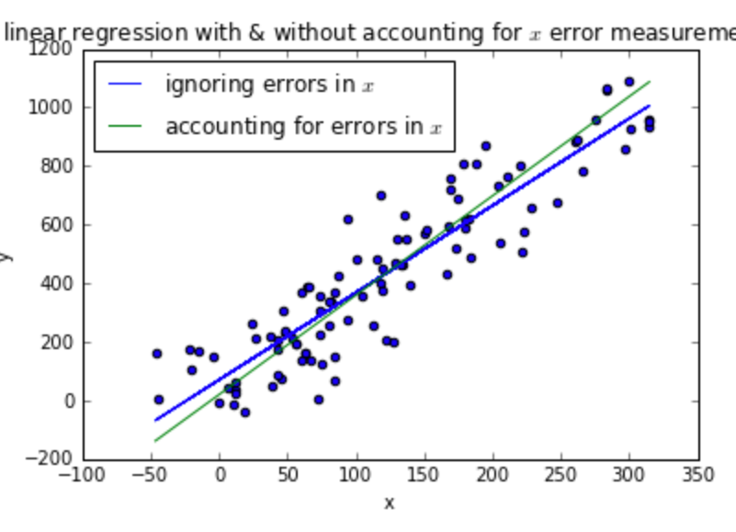
Linear Regression
Relationship between target and features
Find a line that best fits the data

Slide 11
Linear Regression
y = wx + a
y -> target
x -> feature
w -> weight
y = f(x₁, x₂, x₃, x₄ ,…, x_{n})
y_{k} = w₁x_{k1} +w₂x_{k2} + w₃x_{k3} + w₄x_{k4} +…+ w_{n}x_{kn} + w₀

Slide 12
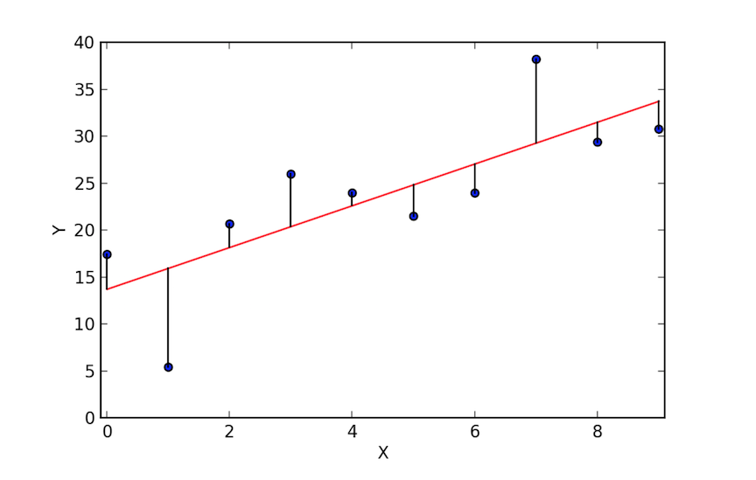
Linear Regression
Goal: Reduce residuals (loss)
Least square method
Try to minimize the sum-of-squares error
LS

Slide 13
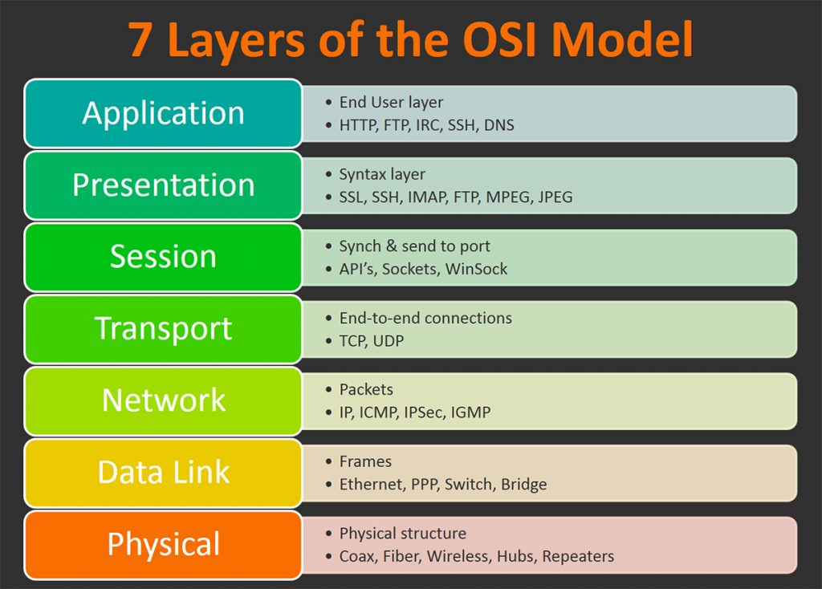
HTTP (Hypertext Transfer Protocol)
Application layer protocol
Top of the OSI Model
Used to deliver data on the web.
Stateless
Requests / Responses

Slide 14
HTTP Communication Flow
A HTTP client establishes a connection.
Sends a HTTP Request to retrieve back some data.
The server receives that request,
Finds the data the client was asking for.
Prepares the HTTP Response with the data.
The server returns the HTTP Response to the client.
The connection between the two is terminated.

Slide 15
JSON over HTTP
POST /api/login HTTP/1.1
Content-Type: application/json
{
"username": "admin",
"password": "admin"
}
HTTP/1.1 200 OK
Content-Type: application/json
{
"access_token": "Axd0amasjbai901iu2bieuq==",
"refresh_token": "Aisndoaisnd1iu2983asd="
}

Slide 16
Programming Language HTTP libraries.
Python: FastAPI, Flask, Django
Golang: net/http, gorrilla/mux
Nodejs: ExpressJS
Java: Spring Boot

Slide 17
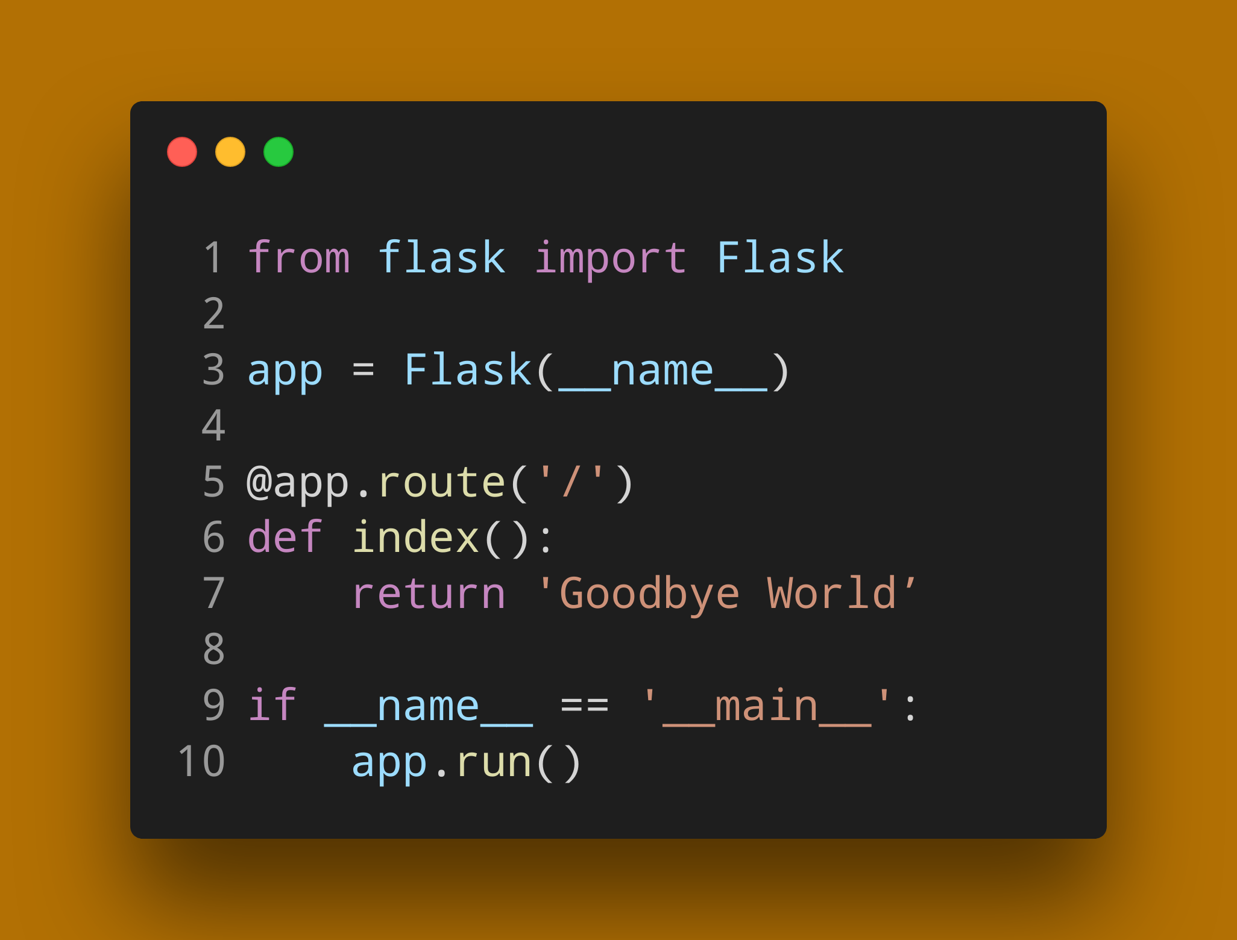
Python Flask Http server

Slide 18
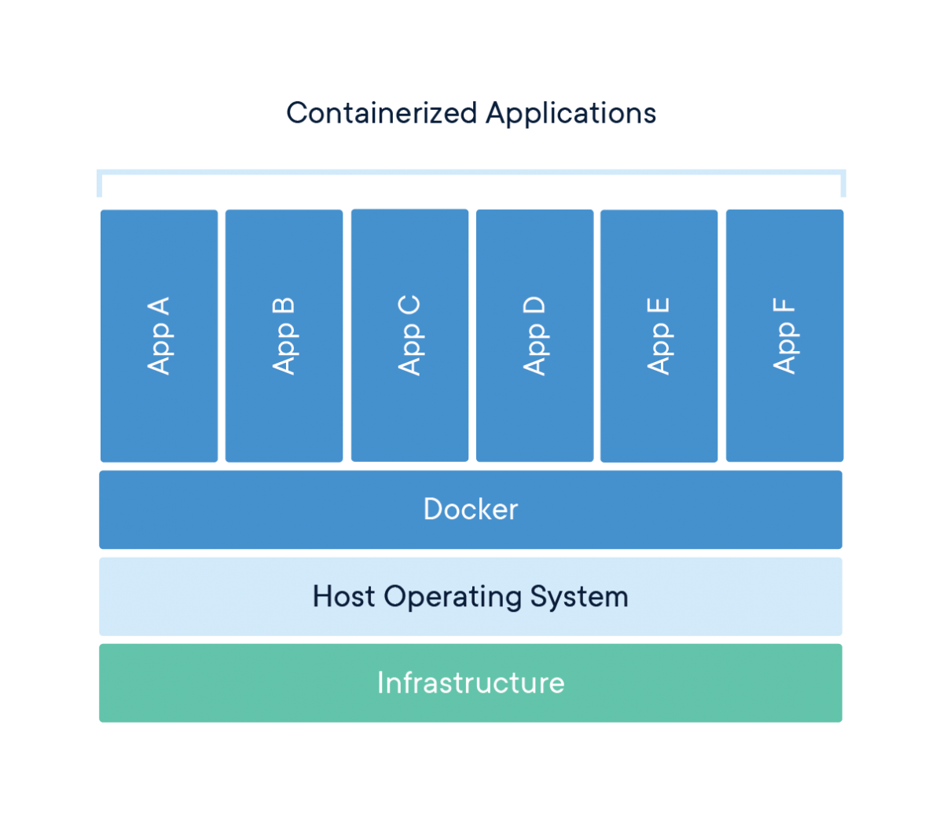
Docker Container Engine
Docker Images:
Lightweight standalone, executable package of software.
Includes everything needed to run an application.
Docker images become containers at runtime.
Docker Containers:
Isolate software from its environment.
Isolates containers from each-other.
Ensure that it works uniformly in every environment and machine.
No more: "IT RUNS ON MY MACHINE, YOURS IS BROKEN"

Slide 19
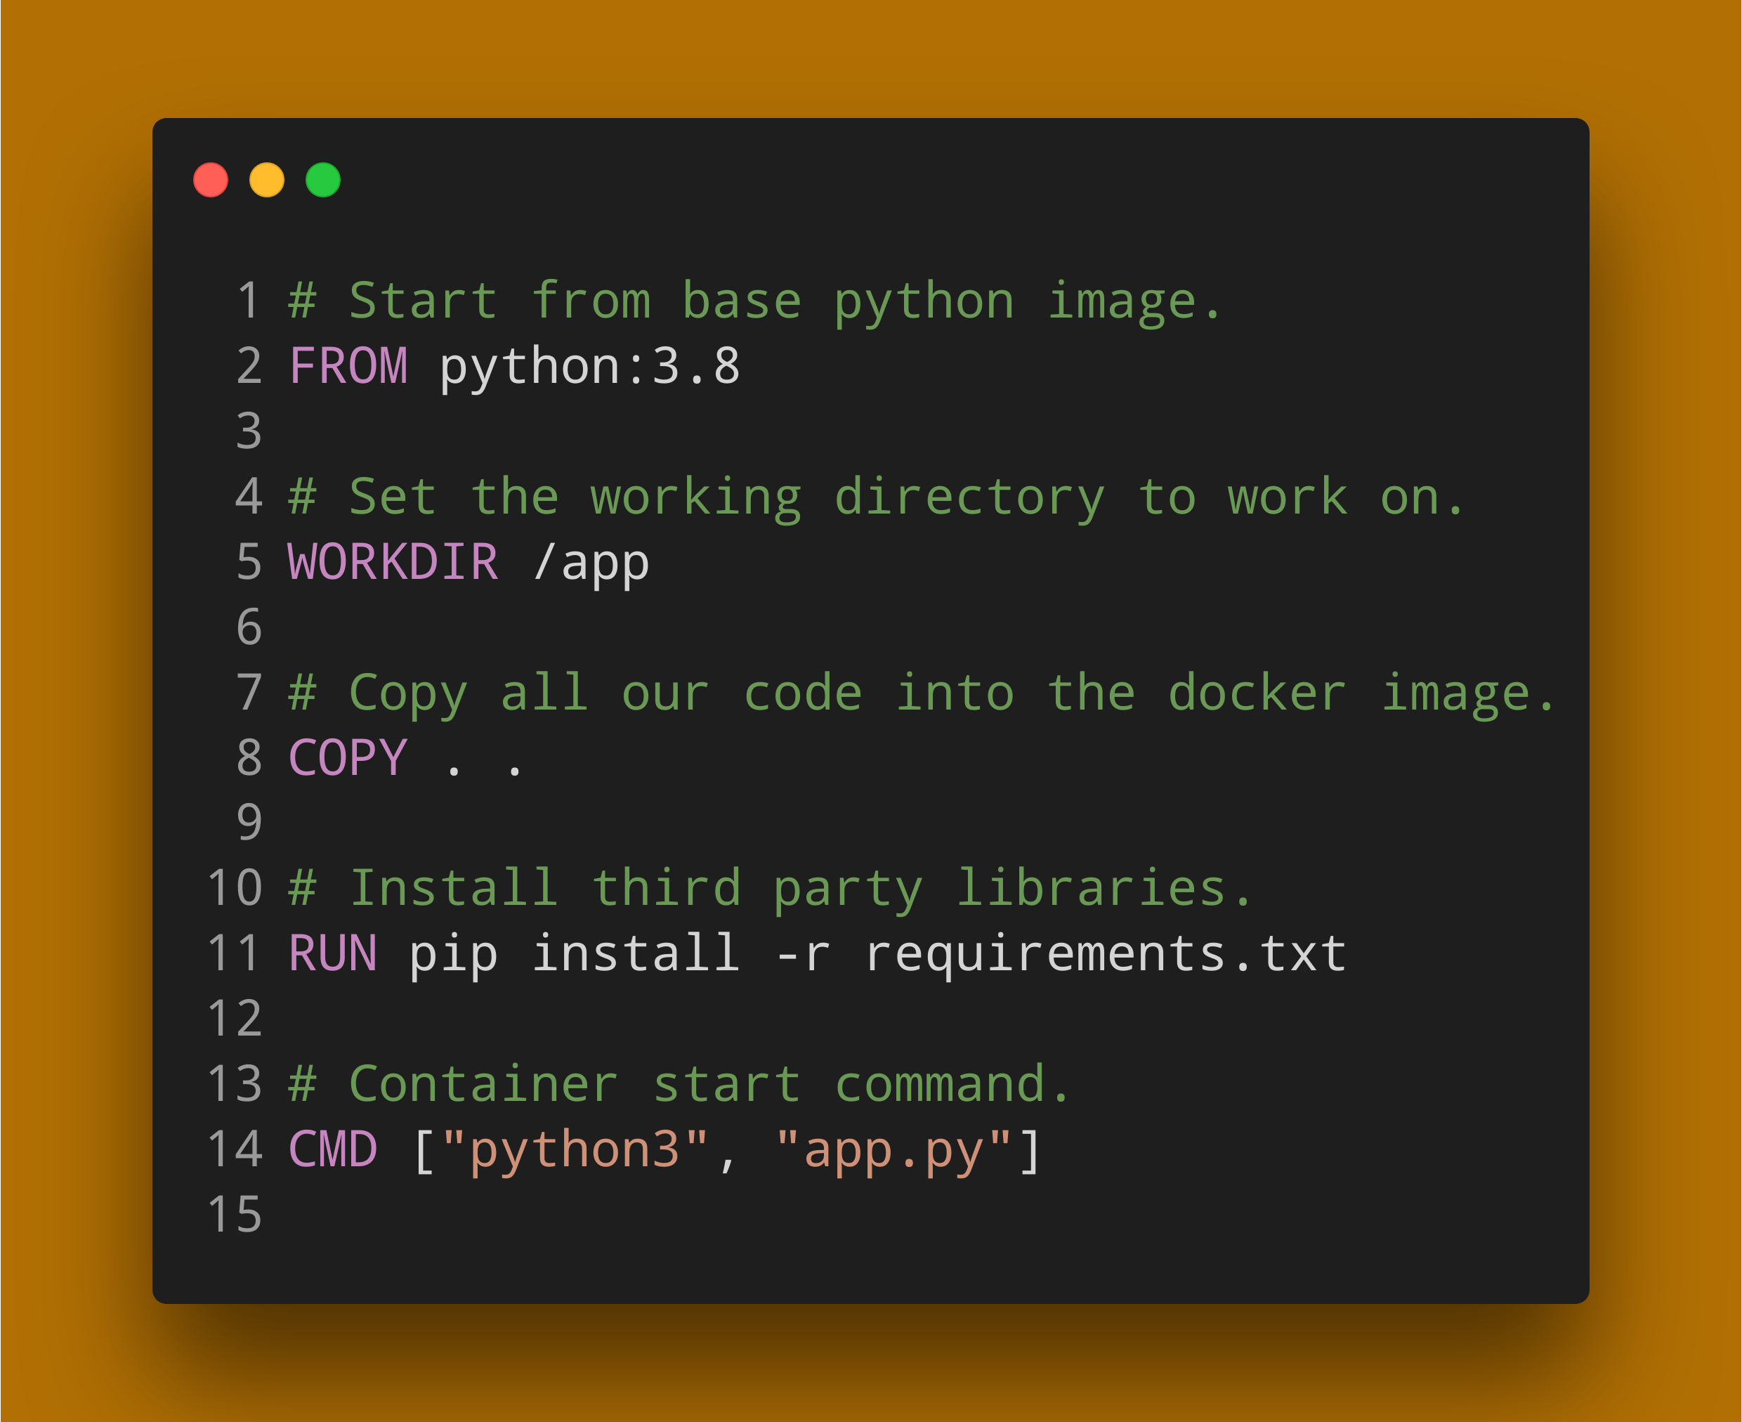
Dockerfile for our HTTP Server.

Slide 20
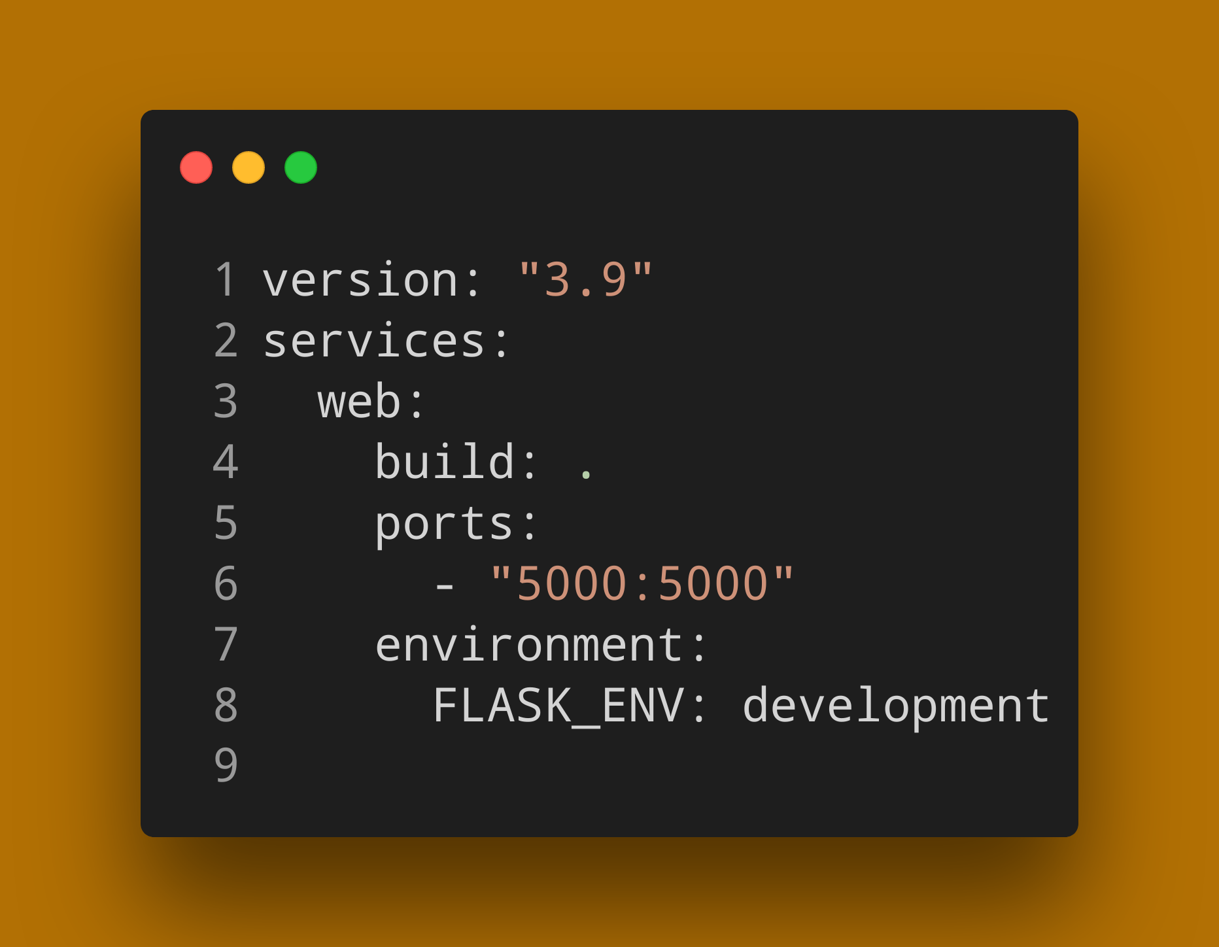
Example Docker Compose File

